Slide 1

EMERGENCY
PREPAREDENESS
Presented by:
Alicia Keeter
South Walton Utility Co., Inc.

Slide 2



Where to Begin
System Assessment
Personnel Assessment
Equipment Assessment
Mutual Aid Agreement
Assess, Plan, Train, Respond, Recover
Notes:
What are your critical assets? Where are you vulnerable
WWTP, water wells, lift stations, scada system,
Do you have spare parts on hand for critical assests,
By pass pumps

Slide 3





Resources for Your Plan
https://flwatertracker.com/
EPA- Route to Resilience
  https://www.epa.gov/waterutilityresponse
https://www.epa.gov/emergency-response

Slide 4

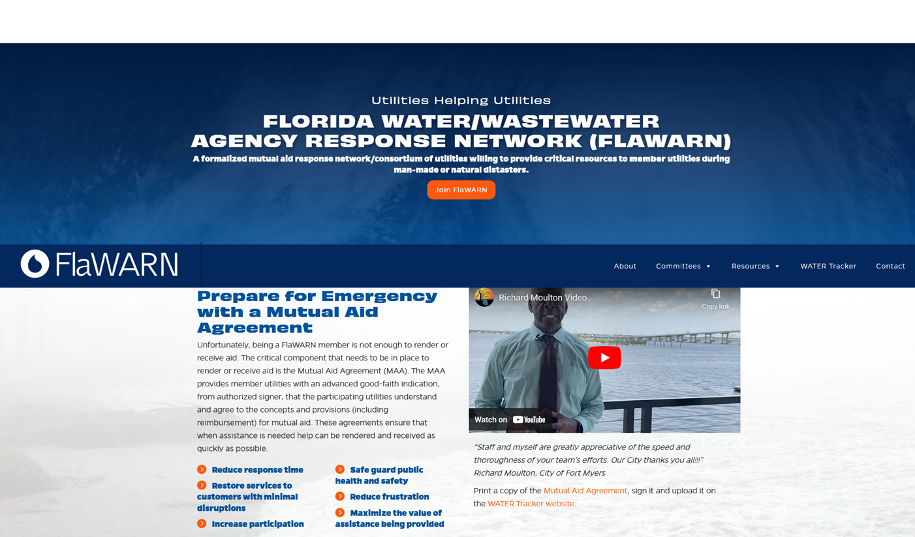

Slide 5
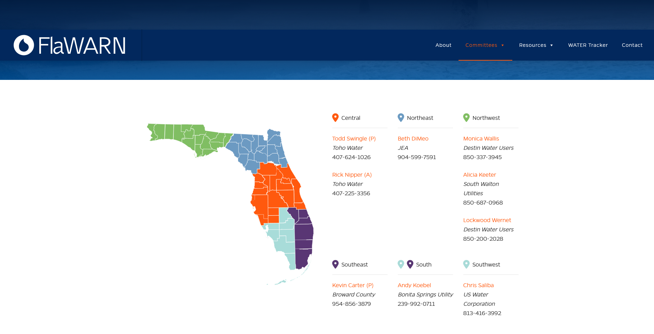

Slide 6
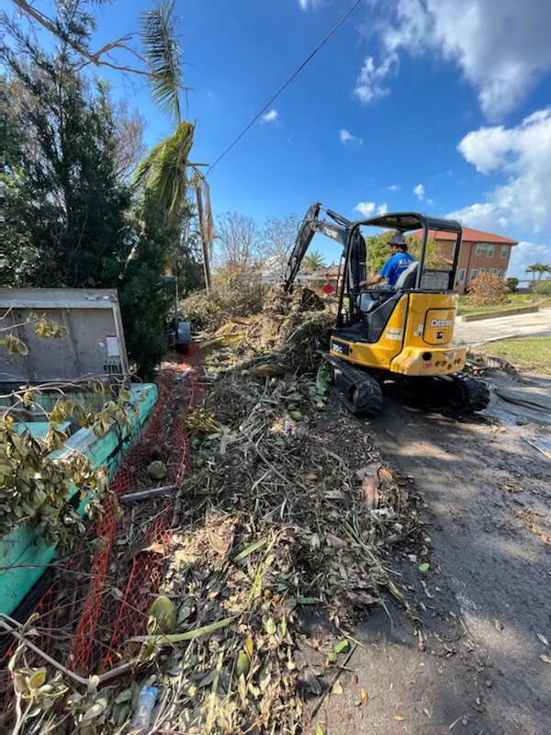

What We Don’t Do
How We Help
Document with photos
Clean up debris
Help you make repairs
Stop the Sanitary sewer overflows
Let you get some rest after a long 14+ hour day
Notes:
What are your critical assets? Where are you vulnerable
WWTP, water wells, lift stations, scada system,
Do you have spare parts on hand for critical assests,
By pass pumps

Slide 7
Emergency Response at Home
GIS/Maps
for water/ sewer system
Housing needs for out of town assistance
Meals for teams assisting in recovery
Coordination efforts depending upon size of system
Telephone communication
Notes:
Maps for your system for outside help to know where to go
Local church, community center, ymca, disaster relief shelters, hotels in area to block out rooms
Food preparation, grocery stores

Slide 8
Mutual aid agreement in place prior to deployment
Local contact, i.e. Rural water circuit rider, FlaWARN representative
Supplies for your team prior to deployment including fuel supply
Lodging needs or being self sufficient
Cash for teams to purchase fuel, supplies, etc.
Emergency Response away from home

Slide 9

Alicia Keeter
South Walton Utility
aak@swuci.org
850-837-2988
This Photo by Unknown Author is licensed under CC BY-SA

